Slide 1
ATM PROJECT
Present by,
YuvasriSankar

Slide 2
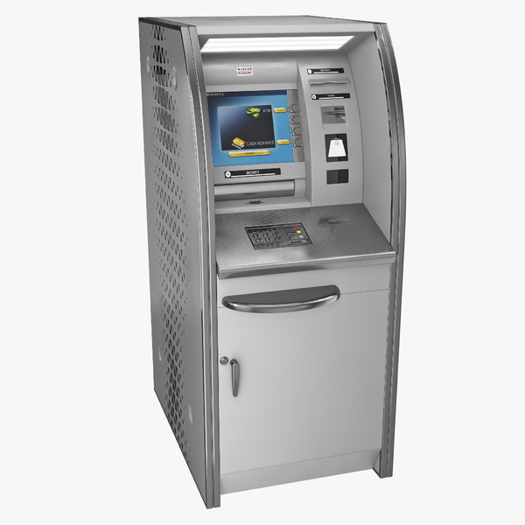
Agenda
Introduction
ATM
Use of ATM
Objectives of project
Features
Scope of project
Language &Tool
Use Case Diagram
Advantages
Disadvantages

Slide 3
Introduction
The term ATM stands for Automated Teller Machine.
It is an electronic device that is used by only bank customers to process account transactions.
The users access their accounts through a special type of plastic card that is encoded with user information on a magnetic strip.
The strip contains an identification code that is transmitted to the bank’s central computer by modem.
The users insert the card into ATMs to access the account and process their account transactions.
The automated teller machine was invented by John Shepherd-Barron in the year 1960.

Slide 4
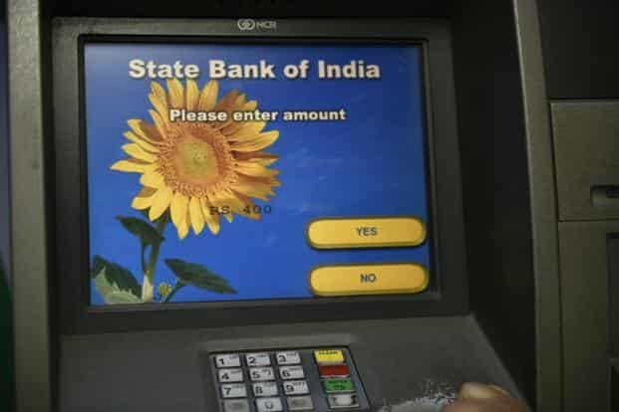
Automated Teller Machine(ATM)
An ATM is an electronic banking machine that allows customers to withdraw money with an ATM card and perform other banking transactions without the aid of banking staff.

Slide 5
Uses of ATM
Cash Withdrawal and Balance Enquiry
Bill Payments
Cash Deposit
Bank a/c holders can also transfer money or change the PIN (Personal Identification Number)

Slide 6
Objectives of ATM project
To analyses & discuss the strategic issues present in Automated Teller Machine
To make observation about the concepts & functions.
To link theoretical knowledge with real life.

Slide 7
Features
Transfer funds between linked bank accounts.
Receive account balance.
Prints recent transactions list.
Change your pin.
Deposit your cash.
Prepaid mobile recharge.
Bill payments.
Cash withdrawal.

Slide 8
Scope of ATM Project
Debit or credit card information ·
Pin code ·
Transaction charge ·
Deposit limit per transaction ·
Deposit limit per day ·

Slide 9
Language &Tool
Language : Core Java
Tool: Eclipse

Slide 10
UseCase Diagram:

Slide 11
Advantages ATM
Access to hard Cash Anywhere at Anytime
ATM Machines offer Financial Inclusion
ATM Machines offer wide range of services
ATM machines are Cheaper to Maintain
ATM machines Serve an Important Function in times of Crisis

Slide 12
Disadvantages ATM
ATM machines can be targeted by criminals, robbers and hackers
ATM Machines May Malfunction
ATM machines Are Costly For The Users
Lack of Personal service

Slide 13
THANK YOU …

